Slide 1

Wellness-Whiz: AI-Powered Health Revolution
Transforming public health through intelligent technology and accessible healthcare information for every community.

Slide 2




The Public Health Crisis We Face
80 Million Worldwide
9 out of 10 Adults
6 in 10 Adults
Struggle with low health literacy, unable to process basic health information effectively
Lack fundamental skills needed to manage their health and prevent disease
Already managing at least one chronic disease with limited understanding
Health illiteracy creates a dangerous cascade of poor outcomes, delayed care, and preventable deaths across our healthcare system.

Slide 3
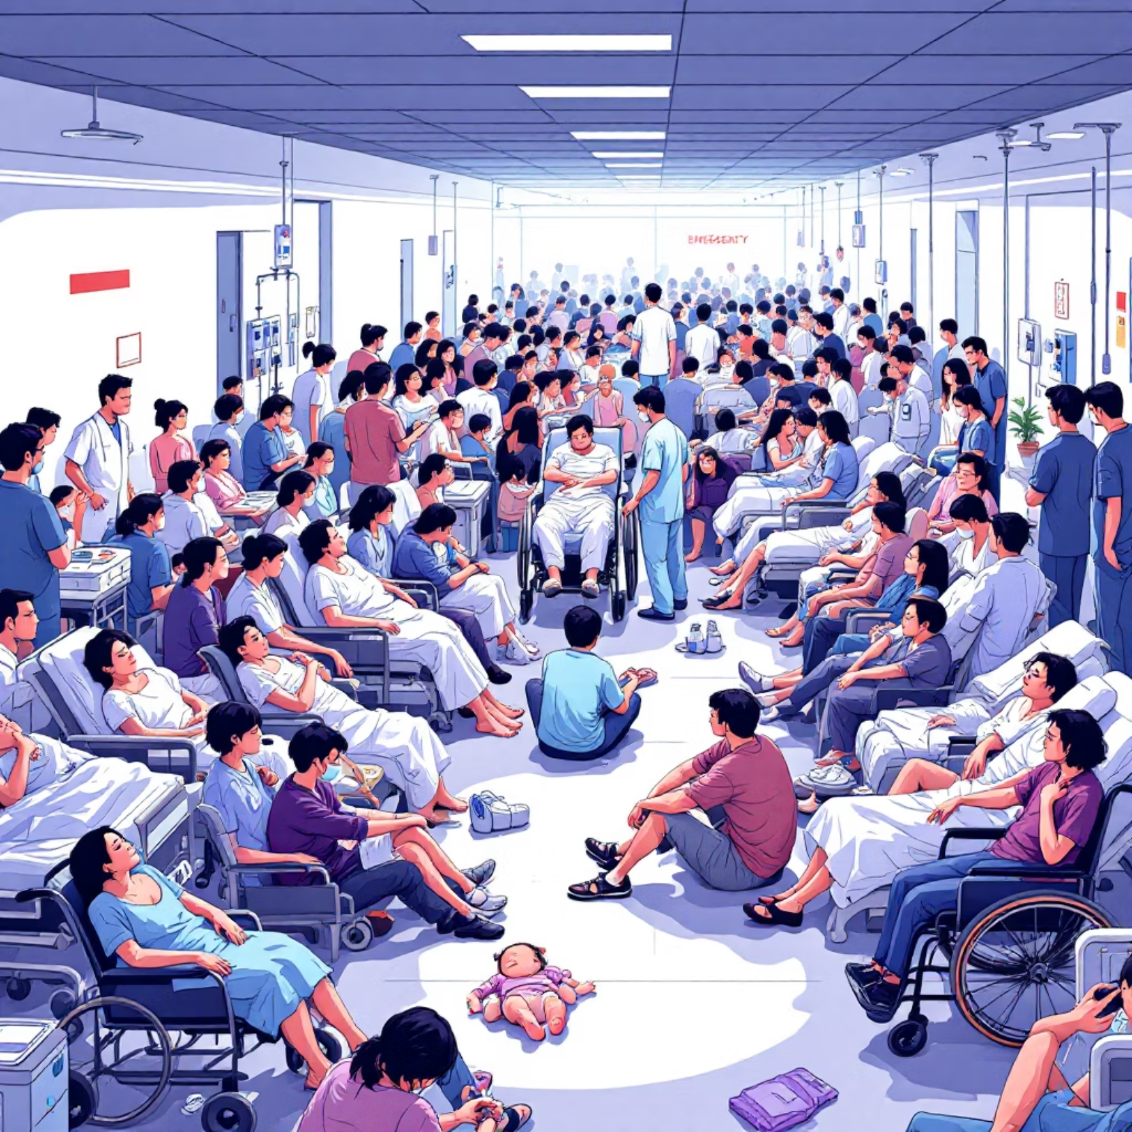


The Human Cost of Health Misinformation
Devastating Real-World Impact
1.5-3x higher risk of adverse health outcomes for those with low health literacy
2x more likely to require hospitalization
800 deaths from a single COVID-19 misinformation claim about methanol
5,876 hospitalizations and 60 cases of permanent blindness from the same false claim
"When health information fails, lives are lost."

Slide 4
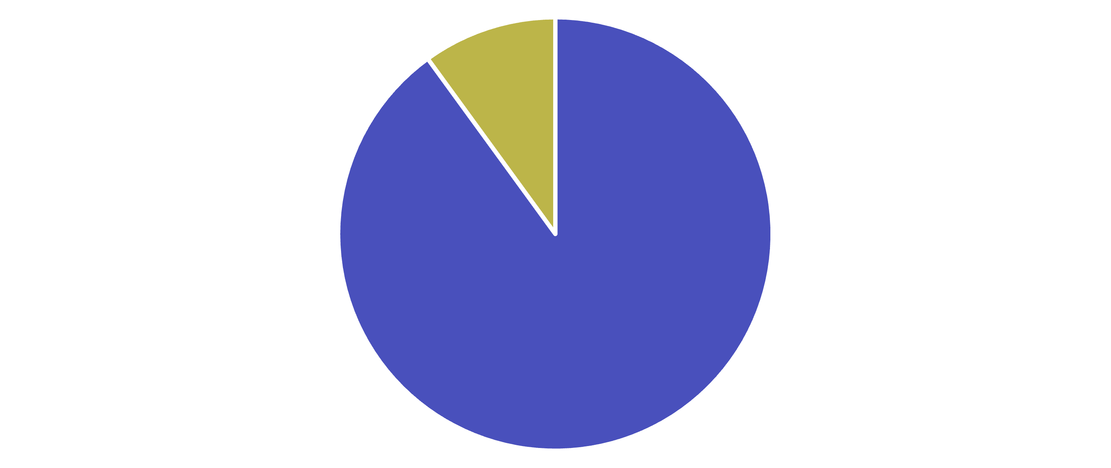



The $4.1 Trillion Problem
90% of healthcare costs go toward managing chronic and mental health conditions—many preventable with better health literacy. Improving health awareness could save $25 billion annually.
Chronic Conditions
Preventable Care

Slide 5

How Misinformation Spreads Faster Than Facts
100x
88%
56%
Viral Advantage
Health Illiteracy Rate
Disrupted Services
False health news reaches 100,000 people while facts reach only 1,000
Adults struggle with understanding basic health information
Essential health services disrupted globally during pandemic peak

Slide 6
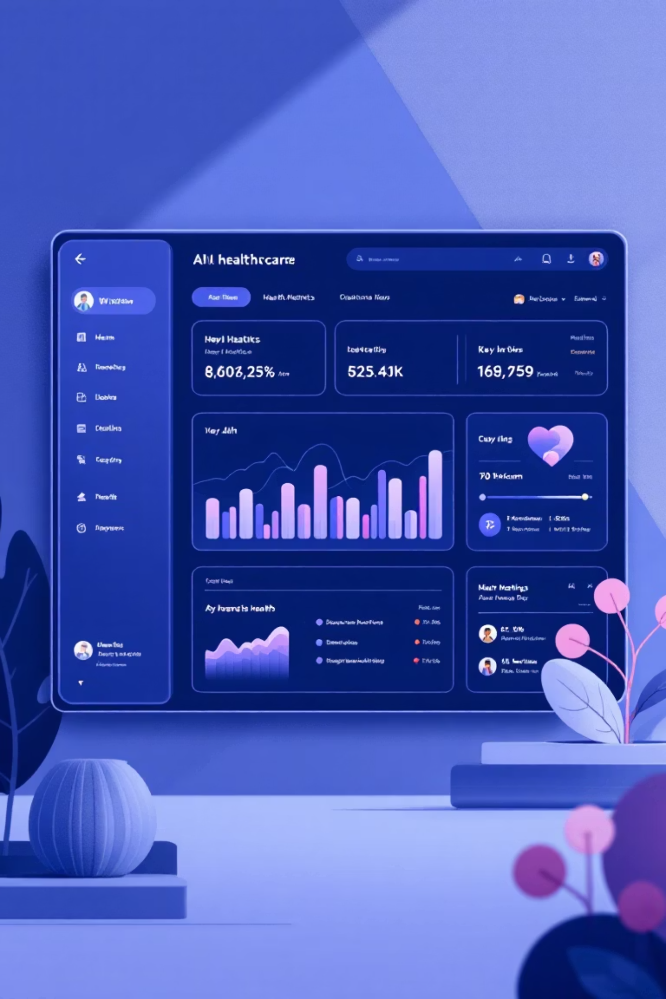


Introducing WellnessWhiz: The Solution
01
02
AI-Powered Health Assistant
Multi-Modal Communication
Advanced Gemini API integration provides accurate, personalized health guidance 24/7
Text-to-speech and voice recognition break down literacy barriers
03
Real-Time Emergency Support
Instant location-based emergency services and nearest healthcare facility finder

Slide 7


Advanced Technical Architecture
Dynamic Prompt Engineering
Audio Processing Innovation
async function callGeminiAPI(userQuery) { const basePrompt = 'WellnessWhiz Assistant'; let instructedQuery = ''; if (currentMode === 'drug') { const drugData = await getDrugInfo(userQuery); instructedQuery = `${basePrompt} Format data: ${JSON.stringify(drugData)}`; } const response = await fetch(apiUrl, { method: 'POST', body: JSON.stringify(payload) });}
Converting raw Google TTS API data into playable audio files through manual WAV header construction and PCM data processing.
Real-time speech synthesis makes health information accessible to users with reading difficulties.

Slide 8





Hackathon Innovation: Breaking Barriers
Instant Local Emergency Support
Geolocation API integration with Google Maps to connect users with nearest hospitals, pharmacies, and emergency services in real-time
Multilingual India Coverage
Complete UI translation and Gemini API multilingual support for Hindi, Tamil, Bengali, and other regional languages
Voice-First Accessibility
Speech recognition and text-to-speech in multiple Indian languages, removing literacy barriers entirely

Slide 9




The Future of Public Health is Here
"Transforming WellnessWhiz from a health information chatbot into an actionable, inclusive public health tool for every citizen—regardless of language, literacy, or location."
Ready to Deploy
Scalable Solution
Life-Saving Impact
Join us in revolutionizing public health through accessible, intelligent technology.

